Slide 1
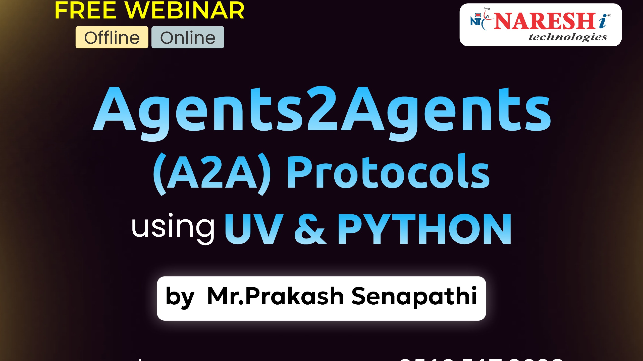

Slide 2
LLM ( Large Language Model)
🧠 LLM (Large Language Model)
Think of LLMs like brains that understand and generate human-like language.
Examples: GPT-4, Claude, Gemini, Mistral.
Trained on massive text data.
Can answer questions, generate content, write code, etc.
💬 What it does: “Tell me a joke” → Writes a funny one-liner.

Slide 3
AGENTIC AI
🤖 Agentic AI
Now imagine giving that brain goals, tools, and memory — it becomes an agent that can act on its own.
Agentic AI = LLM + memory + reasoning + tools + autonomy.
Can perform multi-step tasks on its own.
Example: “Plan a weekend trip and book tickets” → Agent books, compares prices, checks calendar.
💡 What it does: Not just answers, but acts intelligently over time.

Slide 4
What is A2A
A2A stands for Agents-to-Agents communication—a modern approach where autonomous software agents communicate, collaborate, and make decisions without human intervention.
These agents can be:
🤖 Bots ⚙️ Microservices 🧠 AI models 🛠️ Autonomous tools
Imagine a travel booking assistant:
One agent checks flights ✈️ Another searches for hotels 🏨A third handles payment 💳
These agents communicate automatically using A2A protocols—coordinating in real time to complete the task.
https://developers.googleblog.com/en/a2a-a-new-era-of-agent-interoperability/
https://google.github.io/A2A/
Github: https://github.com/google/A2A

Slide 5
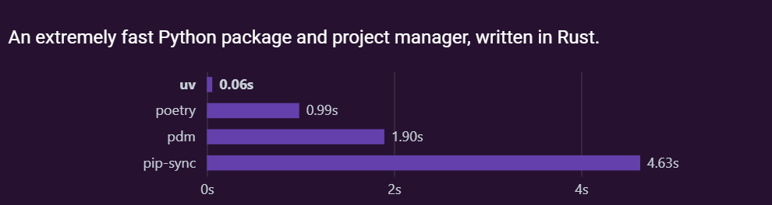
uv - Python
https://docs.astral.sh/uv/guides/install-python/
An extremely fast Python package
and project manager, written in Rust.
uv python install
uv run .
uv run main.py

Slide 6

Previous Workshop Title
1- Resume Building Bootcamp for Data Analytics, BA, Data Science & GEN AI Roles ➔
playlist?list=PLVlQHNRLflP-SaPff3325gkISMHEznEix
2- Agenitic AI ➔ playlist?list=PLVlQHNRLflP8Pt3wVlRWRaXZXi79cIwSq
3- Data Analytics & Business Analytics ➔ playlist?list=PLVlQHNRLflP-BgYmMlM8YQpvQM2J99HE0
4- Generative AI ➔ playlist?list=PLVlQHNRLflP81c99eg7UhkVZxwPvhTddM
5- Python for Data science ➔ playlist?list=PLVlQHNRLflP9GN5rc8sBWnrV53DWAzfdn
6- AZUR AI (Cognitive Services) ➔ playlist?list=PLVlQHNRLflP8JthpjvJFaofUkJS1A7qa1
7- MCP ➔ www.youtube.com/watch?v=6Ll5uB8VQto
8- A2A ➔

Slide 7
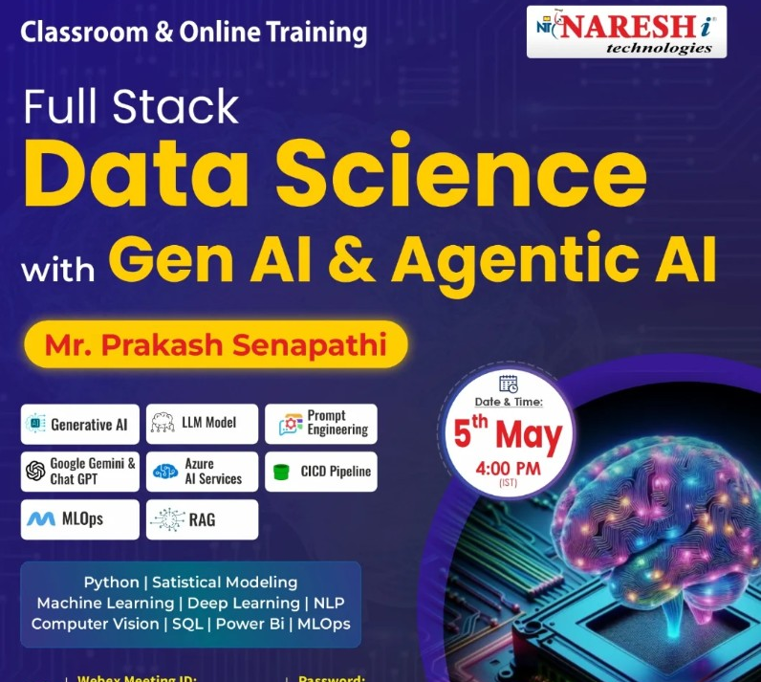
Join my New Batch on FSDS with Gen AI & Agentic AI
Joining URL:
https://web.webex.com/join-meeting
Meeting Id: 2519 276 1117
Password: 112233

Slide 8
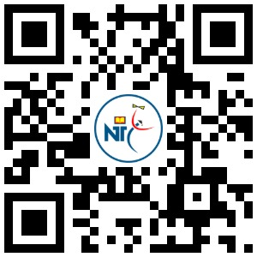
My Linkedin –> https://www.linkedin.com/in/kodi-prakash-senapati-a95a60182/
Follow this link to join my WhatsApp community ➔ Full Stack DATA SCIENCE with GEN AI & Agentic AI ➔
https://chat.whatsapp.com/LYRg0wQ3Mph6JE0nkSnoAM
Q & A

